Slide 1

CHAPTER 10
GRAPHS AND TREES
Copyright © Cengage Learning. All rights reserved.

Slide 2
SECTION 10.7
Spanning Trees and Shortest Paths
Copyright © Cengage Learning. All rights reserved.

Slide 3
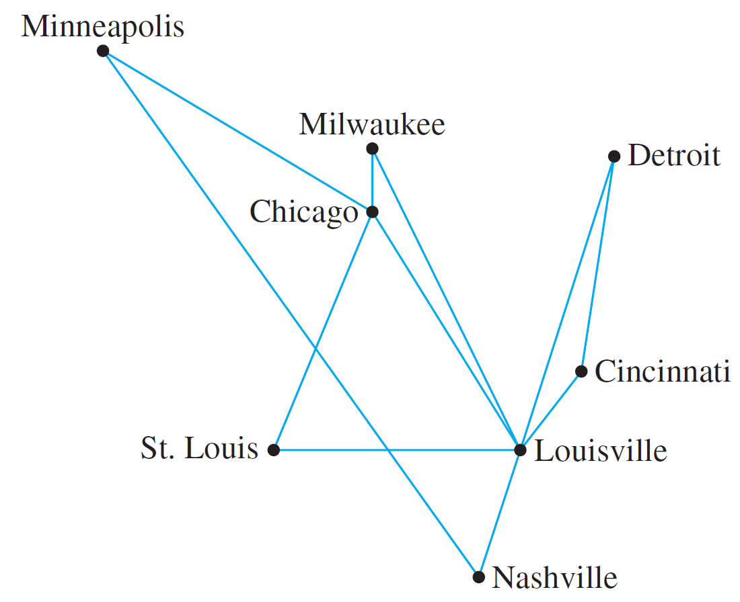
Spanning Trees and Shortest Paths
An East Coast airline company wants to expand service to the Midwest and has received permission from the Federal Aviation Authority to fly any of the routes shown in
Figure 10.7.1.
Figure 10.7.1

Slide 4
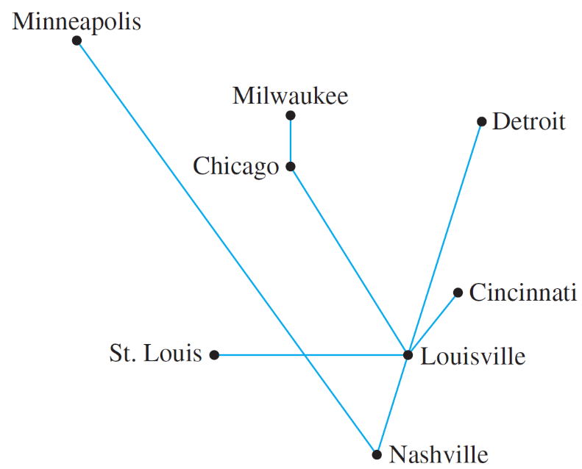
Spanning Trees and Shortest Paths
The company wishes to legitimately advertise service to all the cities shown but, for reasons of economy, wants to use the least possible number of individual routes to connect them. One possible route system is given in Figure 10.7.2.
Figure 10.7.2

Slide 5
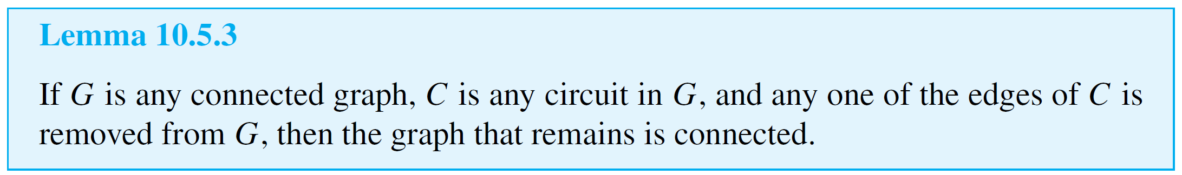
Spanning Trees and Shortest Paths
Clearly this system joins all the cities. Is the number of individual routes minimal? The answer is yes, and the reason may surprise you.
The fact is that the graph of any system of routes that satisfies the company’s wishes is a tree, because if the graph were to contain a circuit, then one of the routes in the circuit could be removed without disconnecting the graph (by Lemma 10.5.3), and that would give a smaller total number of routes.

Slide 6
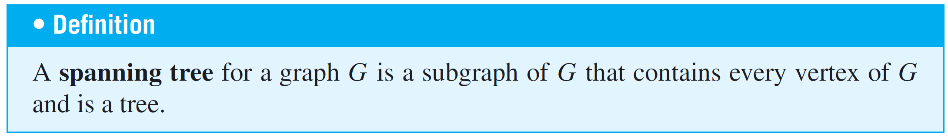
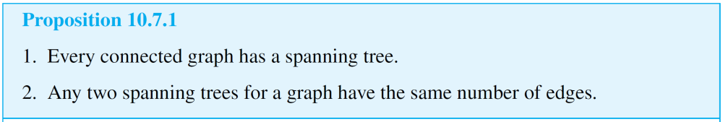
Spanning Trees and Shortest Paths
But any tree with eight vertices has seven edges. Therefore, any system of routes that connects all eight vertices and yet minimizes the total number of routes consists of seven routes.

Slide 7
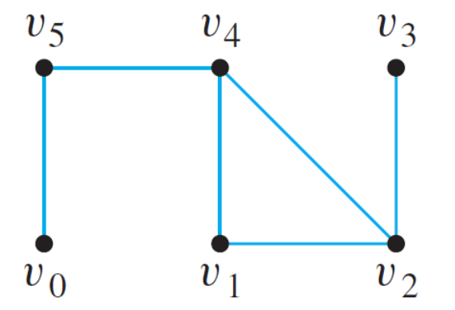
Example 1 – Spanning Trees
Find all spanning trees for the graph G pictured below.
Solution:
The graph G has one circuit v₂v₁v₄v₂, and removal of any edge of the circuit gives a tree.

Slide 8
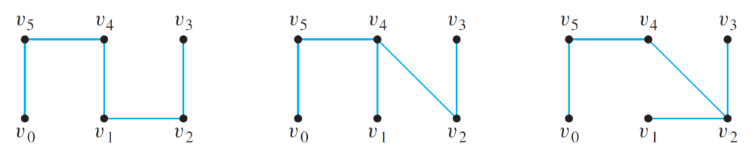
Example 1 – Solution
cont’d
Thus, as shown below, there are three spanning trees
for G.

Slide 9
Minimum Spanning Trees

Slide 10
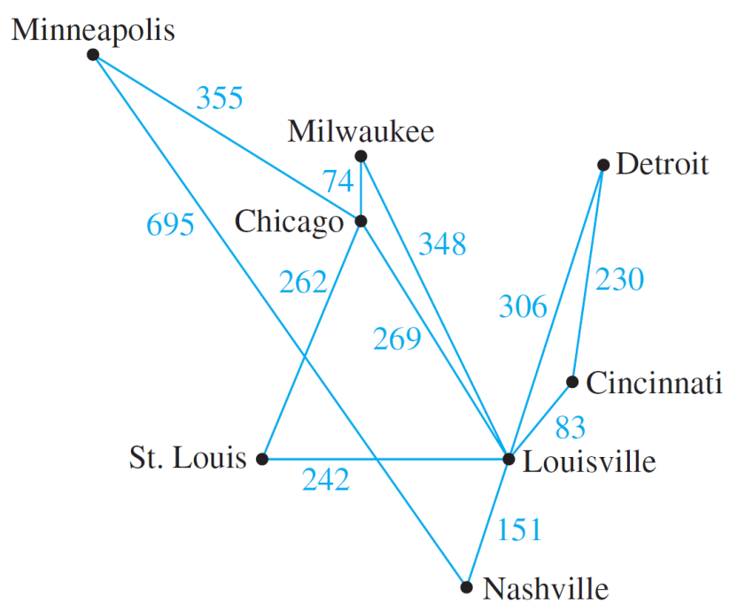

Minimum Spanning Trees
The graph of the routes allowed by the Federal Aviation Authority shown in Figure 10.7.1 can be annotated by adding the distances (in miles) between each pair of cities. This is done in Figure 10.7.3.
Figure 10.7.3
Figure 10.7.1

Slide 11
Minimum Spanning Trees
Now suppose the airline company wants to serve all the cities shown, but with a route system that minimizes the total mileage.
Note that such a system is a tree, because if the system contained a circuit, removal of an edge from the circuit would not affect a person’s ability to reach every city in the system from every other (again, by Lemma 10.5.3), but it would reduce the total mileage of the system.

Slide 12
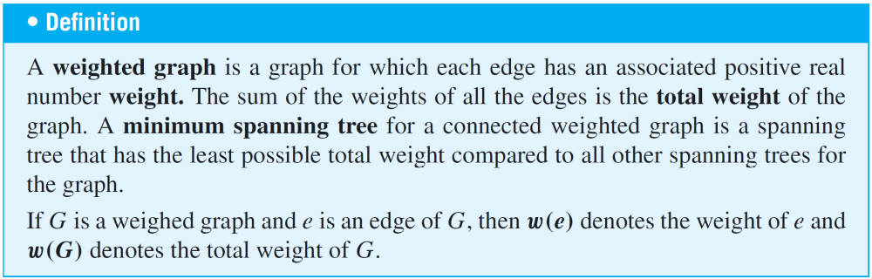
Minimum Spanning Trees
More generally, a graph whose edges are labeled with numbers (known as weights) is called a weighed graph.
A minimum-weight spanning tree, or simply a minimum spanning tree, is a spanning tree for which the sum of the weights of all the edges is as small as possible.

Slide 13
Kruskal’s Algorithm

Slide 14
Kruskal’s Algorithm
In Kruskal’s algorithm, the edges of a connected weighted graph are examined one by one in order of increasing weight.
At each stage the edge being examined is added to what will become the minimum spanning tree, provided that this addition does not create a circuit.
After n – 1 edges have been added (where n is the number of vertices of the graph), these edges, together with the vertices of the graph, form a minimum spanning tree for the graph.

Slide 15
Kruskal’s Algorithm
Algorithm 10.7.1 Kruskal
Input: G [a connected weighted graph with n vertices, where n is a positive integer]
Algorithm Body:
[Build a subgraph T of G to consist of all the vertices of G with edges added in order of increasing weight. At each stage, let m be the number of edges of T.]
1. Initialize T to have all the vertices of G and no edges.
2. Let E be the set of all edges of G, and let m := 0.

Slide 16
Kruskal’s Algorithm
3. while (m < n – 1)
3a. Find an edge e in E of least weight.
3b. Delete e from E.
3c. if addition of e to the edge set of T does not
produce a circuit
then add e to the edge set of T and set m := m + 1
end while
Output: T [T is a minimum spanning tree for G.]

Slide 17
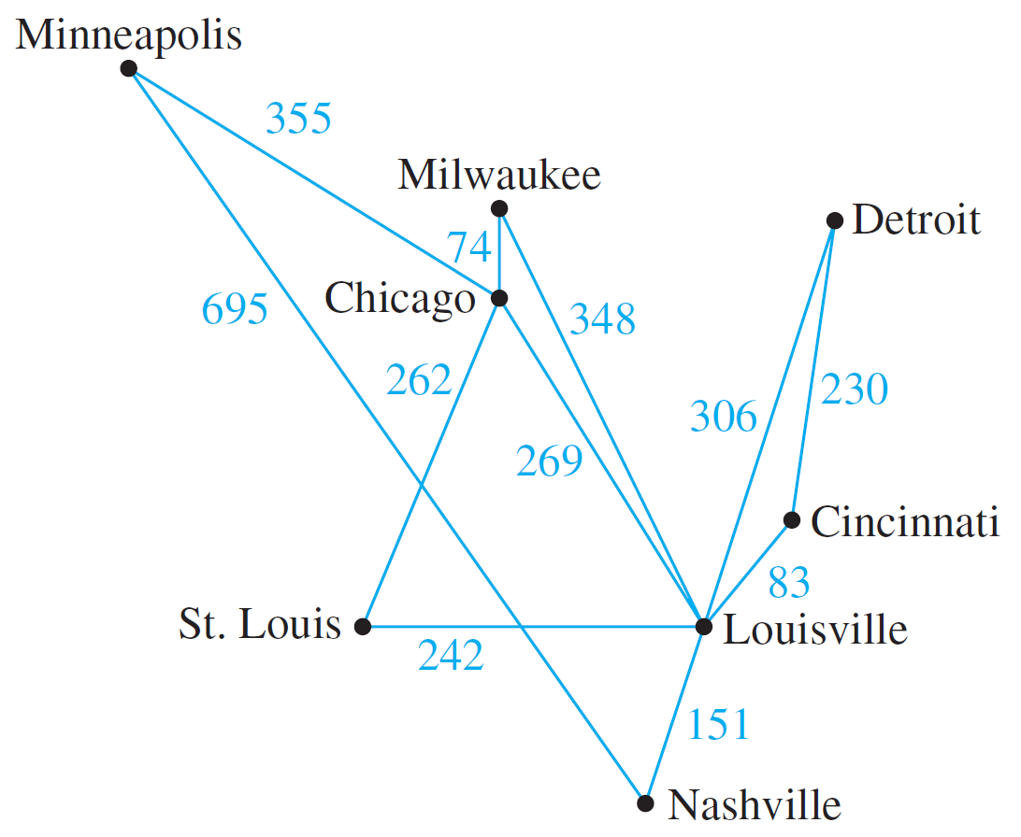
Example 2 – Action of Kruskal’s Algorithm
Describe the action of Kruskal’s algorithm on the graph shown in Figure 10.7.4, where n = 8.
Figure 10.7.4

Slide 18
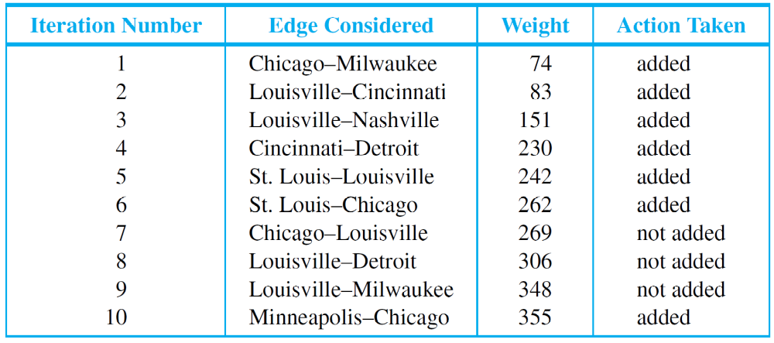
Example 2 – Solution
Using Kruskal’s algorithm we can formulate the following table.

Slide 19
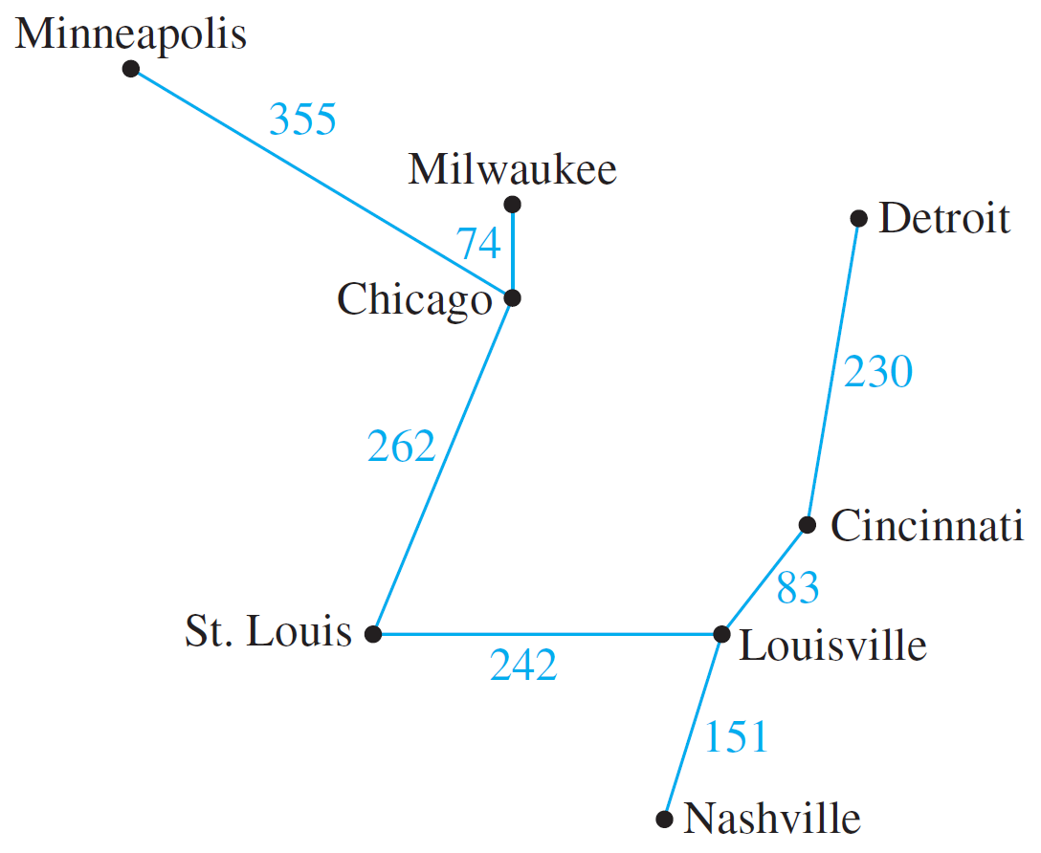
Example 2 – Solution
cont’d
The tree produced by Kruskal’s algorithm is shown in Figure 10.7.5.
Figure 10.7.5

Slide 20
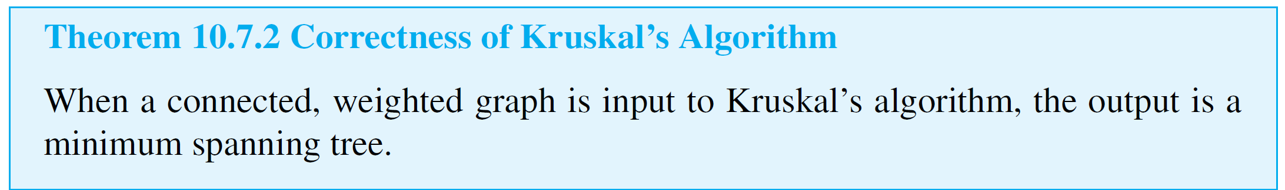
Kruskal’s Algorithm
When Kruskal’s algorithm is used on a graph in which some edges have the same weight as others, more than one minimum spanning tree can occur as output.
To make the output unique, the edges of the graph can be placed in an array and edges having the same weight can be added in the order they appear in the array.

Slide 21
Prim’s Algorithm

Slide 22
Prim’s Algorithm
Prim’s algorithm works differently from Kruskal’s. It builds a minimum spanning tree T by expanding outward in connected links from some vertex.
One edge and one vertex are added at each stage. The edge added is the one of least weight that connects the vertices already in T with those not in T, and the vertex is the endpoint of this edge that is not already in T.

Slide 23
Prim’s Algorithm
Algorithm 10.7.2
Input: G [a connected weighted graph with n vertices where n is a positive integer]
Algorithm Body:
[Build a subgraph T of G by starting with any vertex v of G and attaching edges (with their endpoints) one by one to an as-yet-unconnected vertex of G, each time choosing an edge of least weight that is adjacent to a vertex of T.]
1. Pick a vertex v of G and let T be the graph with one
vertex, v, and no edges.

Slide 24
Prim’s Algorithm
2. Let V be the set of all vertices of G except v.
3. for i := 1 to n – 1
3a. Find an edge e of G such that (1) e connects T
to one of the vertices in V, and (2) e has the
least weight of all edges connecting T to a vertex in
V. Let w be the endpoint of e that is in V.
3b. Add e and w to the edge and vertex sets of T, and
delete w from V.
next i
Output: T [T is a minimum spanning tree for G.]

Slide 25
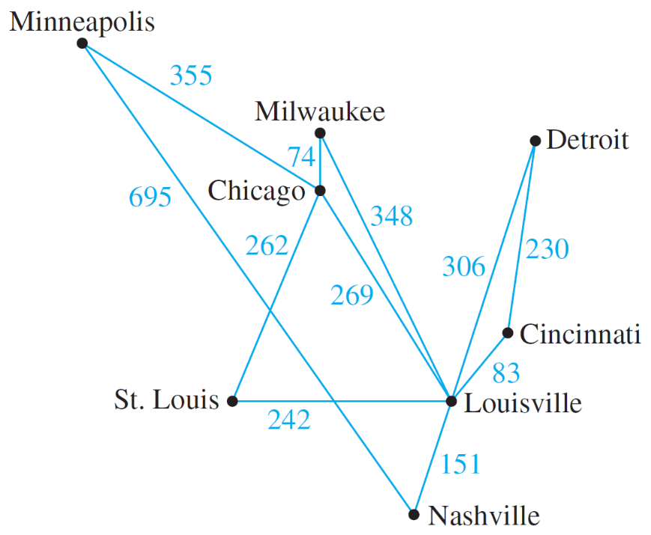
Example 3 – Action of Prim’s Algorithm
Describe the action of Prim’s algorithm for the graph in Figure 10.7.6 using the Minneapolis vertex as a starting point.
Figure 10.7.6

Slide 26
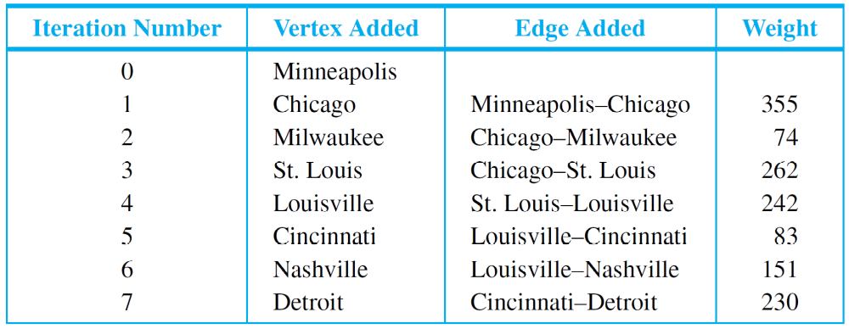
Example 3 – Solution
Using Prim’s algorithm we can formulate the following table.

Slide 27
Prim’s Algorithm
Note that the tree obtained is the same as that obtained by Kruskal’s algorithm, but the edges are added in a different order.
As with Kruskal’s algorithm, in order to ensure a unique output, the edges of the graph could be placed in an array and those with the same weight could be added in the
order they appear in the array.

Slide 28
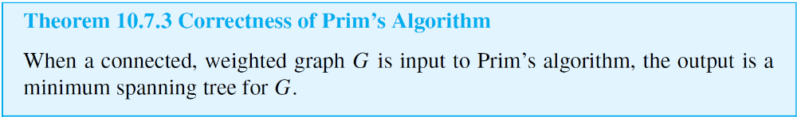
Prim’s Algorithm
It is not hard to see that when a connected graph is input to Prim’s algorithm, the result is a spanning tree. What is not so clear is that this spanning tree is a minimum.

Slide 29
Dijkstra’s Shortest Path Algorithm

Slide 30

Dijkstra’s Shortest Path Algorithm
At the start of execution of the algorithm, each vertex u of G is given a label L(u), which indicates the current best estimate of the length of the shortest path from a to u.
L(a) is initially set equal to 0 because the shortest path from a to a has length zero, but, because there is no previous information about the lengths of the shortest paths from a to any other vertices of G, the label L(u) of each vertex u other than a is initially set equal to a number, denoted , that is greater than the sum of the weights of all the edges of G.

Slide 31
Dijkstra’s Shortest Path Algorithm
As execution of the algorithm progresses, the values of L(u) are changed, eventually becoming the actual lengths of the shortest paths from a to u in G.
Because T is built up outward from a, at each stage of execution of the algorithm the only vertices that are candidates to join T are those that are adjacent to at least one vertex of T.
Thus at each stage of Dijkstra’s algorithm, the graph G can be thought of as divided into three parts: the tree T that is being built up, the set of “fringe” vertices that are adjacent to at least one vertex of the tree, and the rest of the vertices of G.

Slide 32
Dijkstra’s Shortest Path Algorithm
Each fringe vertex is a candidate to be the next vertex added to T.
The one that is chosen is the one for which the length of the shortest path to it from a through T is a minimum among all the vertices in the fringe.
An essential observation underlying Dijkstra’s algorithm is that after each addition of a vertex v to T, the only fringe vertices for which a shorter path from a might be found are those that are adjacent to v [because the length of the path from a to v was a minimum among all the paths from a to vertices in what was then the fringe].

Slide 33
Dijkstra’s Shortest Path Algorithm
So after each addition of a vertex v to T, each fringe vertex u adjacent to v is examined and two numbers are compared: the current value of L(u) and the value of
L(v) + w(v, u), where L(v) is the length of the shortest path to v (in T ) and w(v, u) is the weight of the edge joining v and u.
If L(v) + w(v, u) < L(u), then the value of L(u) is changed to L(v) + w(v, u).
At the beginning of execution of the algorithm, the tree consists only of the vertex a, and L(a) = 0.

Slide 34
Dijkstra’s Shortest Path Algorithm
When execution terminates, L(z) is the length of a shortest path from a to z.
As with Kruskal’s and Prim’s algorithms for finding minimum spanning trees, there is a simple but dramatically inefficient way to find the shortest path from a to z: compute the lengths of all the paths and choose one that is shortest.

Slide 35
Dijkstra’s Shortest Path Algorithm
Algorithm 10.7.3 Dijkstra
Input: G [a connected simple graph with a positive weight for every edge], [a number greater than the sum of the weights of all the edges in the graph], w(u, v) [the weight
of edge {u, v}], a [the starting vertex], z [the ending vertex]
Algorithm Body:
1. Initialize T to be the graph with vertex a and no edges.
Let V(T) be the set of vertices of T, and let E(T) be the
set of edges of T.
2. Let L(a) = 0, and for all vertices in G except a,
let L(u) = . [The number L(x) is called the label of x.]

Slide 36

Dijkstra’s Shortest Path Algorithm
3. Initialize v to equal a and F to be {a}.
[The symbol v is used to denote the vertex most recently
added to T.]
4. while (z V(T))
4a. F := (F – {v}) ∪ {vertices that are adjacent to v
and are not in V(T)}
[The set F is called the fringe. Each time a vertex is
added to T, it is removed from the fringe and the
vertices adjacent to it are added to the fringe if they
are not already in the fringe or the tree T.]

Slide 37



Dijkstra’s Shortest Path Algorithm
4b. For each vertex u that is adjacent to v and is not
in V(T),
if then
[Note that adding v to T does not affect the
labels of any vertices in the fringe F except
those adjacent to v. Also, when L(u) is changed
to a smaller value, the notation D(u) is introduced to
keep track of which vertex in T gave rise to the
smaller value.]

Slide 38
Dijkstra’s Shortest Path Algorithm
4c. Find a vertex x in F with the smallest label
Add vertex x to V(T), and add edge {D(x), x} to E(T)
v := x [This statement sets up the notation for the
next iteration of the loop.]
end while
Output: L(z) [L(z), a nonnegative integer, is the length of the shortest path from a to z.]

Slide 39
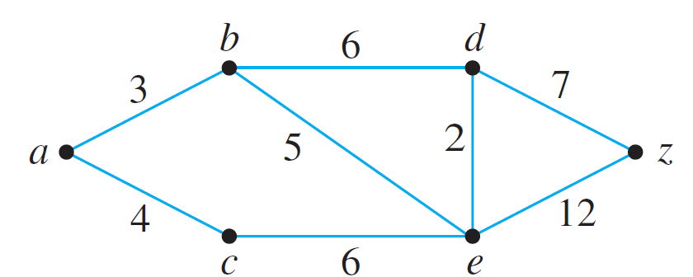
Example 5 – Action of Dijkstra’s Algorithm
Show the steps in the execution of Dijkstra’s shortest path algorithm for the graph shown below with starting vertex a and ending vertex z.

Slide 40
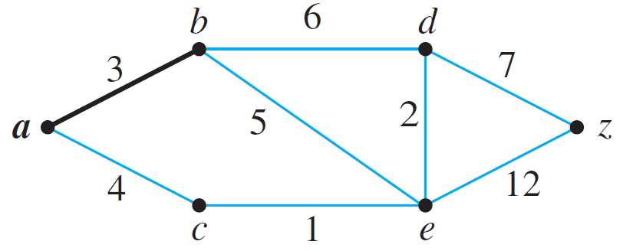
Example 5 – Solution
Step 1: Going into the while loop: V(T ) = {a}, E(T ) = Ø,
and F = {a}
During iteration:
F = {b, c}, L(b) = 3, L(c) = 4. Since L(b) < L(c), b is added to
V(T ) and {a, b} is added to E(T ).

Slide 41
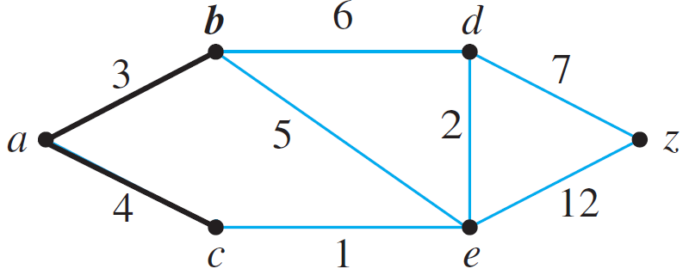
Example 5 – Solution
cont’d
Step 2: Going into the while loop: V(T ) = {a, b},
E(T ) = {{a, b}}
During iteration:
F = {c, d, e}, L(c) = 4, L(d) = 9, L(e) = 8. Since L(c) < L(d) and L(c) < L(e), c is added to V(T ) and {a, c} is added to E(T ).

Slide 42
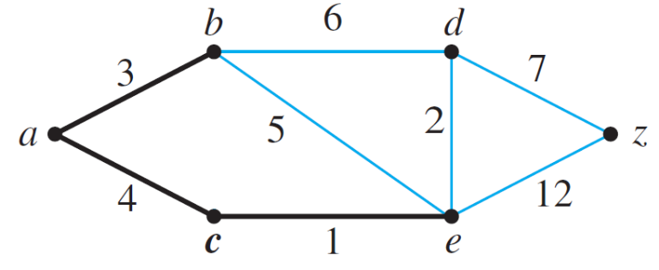
Example 5 – Solution
cont’d
Step 3: Going into the while loop: V(T ) = {a, b, c},
E(T ) = {{a, b}, {a, c}}
During iteration:
F = {d, e}, L(d) = 9, L(e) = 5.
L(e) becomes 5 because ace, which has length 5, is a shorter path to e than abe, which has length 8. Since L(e) < L(d), e is added to V(T ) and {c, e} is added to E(T ).

Slide 43
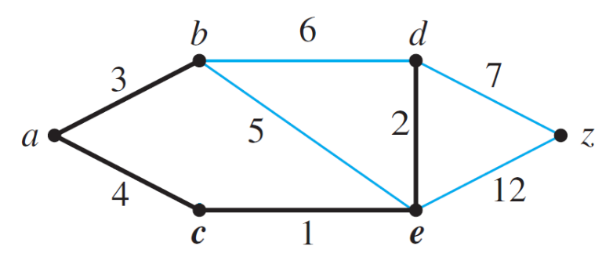
Example 5 – Solution
cont’d
Step 4: Going into the while loop: V(T ) = {a, b, c, e},
E(T ) = {{a, b}, {a, c}, {c, e}}
During iteration:
F = {d, z}, L(d) = 7, L(z) = 17.
L(d) becomes 7 because aced, which has length 7, is a shorter path to d than abd, which has length 9. Since L(d) < L(z), d is added to V(T ) and {e, d} is added to E(T ).

Slide 44
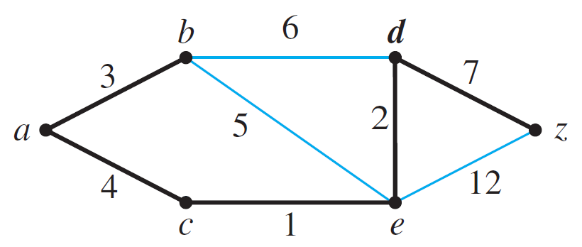
Example 5 – Solution
cont’d
Step 5: Going into the while loop: V(T ) = {a, b, c, e, d},
E(T ) = {{a, b}, {a, c}, {c, e}, {e, d}}
During iteration:
F = {z}, L(z) = 14.
L(z) becomes 14 because acedz, which has length 14, is a shorter path to z than abdz, which has length 17. Since z is the only vertex in F, its label is a minimum, and so z is added to V(T ) and {e, z} is added to E(T ).

Slide 45
Example 5 – Solution
cont’d
Execution of the algorithm terminates at this point because z ∈ V(T ). The shortest path from a to z has length
L(z) = 14.

Slide 46
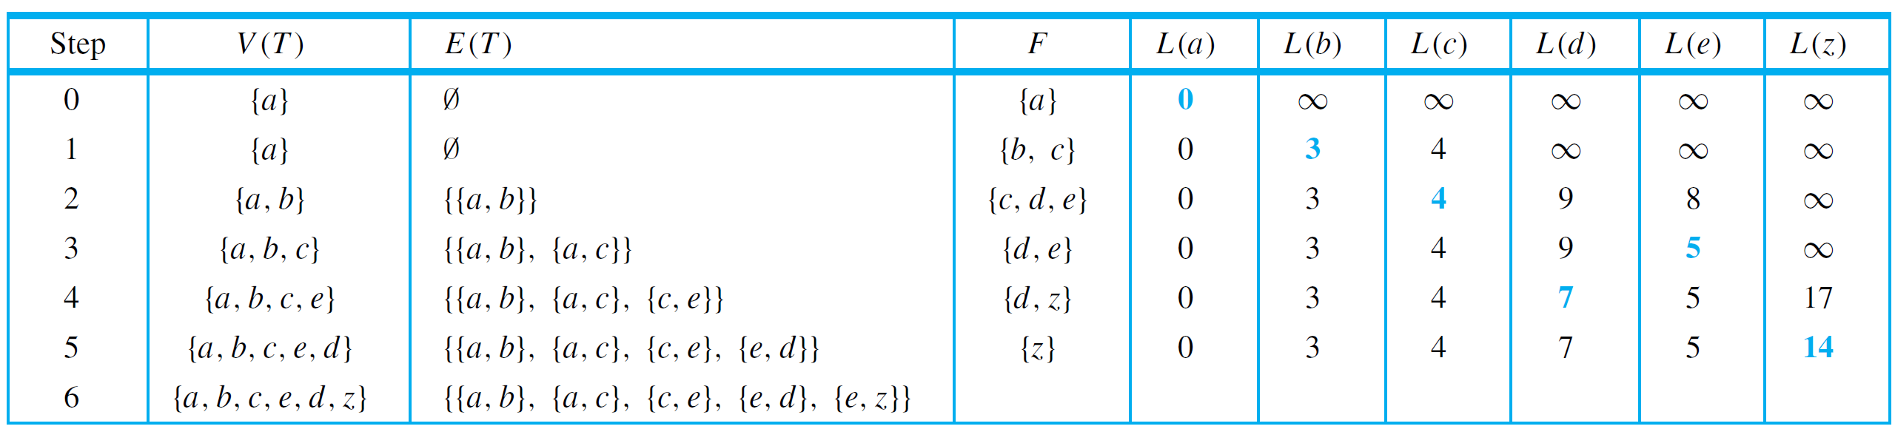
Dijkstra’s Shortest Path Algorithm
Keeping track of the steps in a table is a convenient way to show the action of Dijkstra’s algorithm. Table 10.7.1 does this for the graph in Example 5.
Table 10.7.1

Slide 47
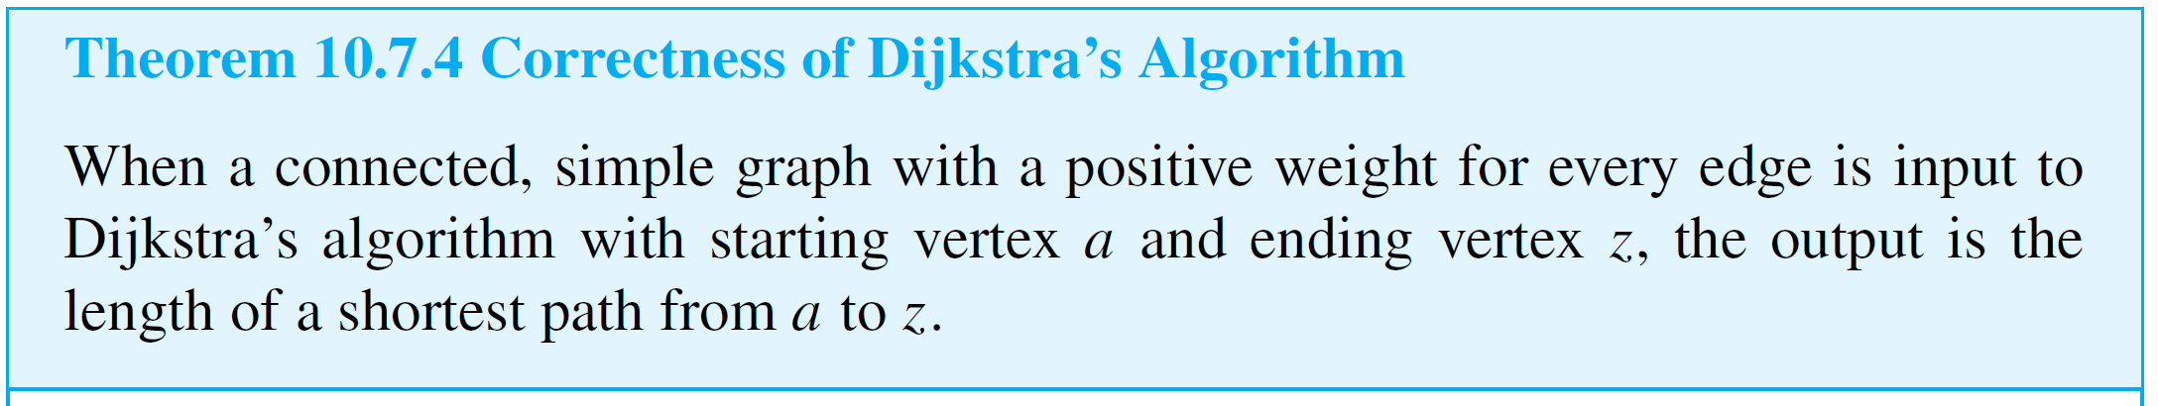
Dijkstra’s Shortest Path Algorithm
It is clear that Dijkstra’s algorithm keeps adding vertices to I until it has added to z.

